Slide 1
Improvement of Radial Strains Calculated from Human OCT Radial Image Scans
Dan Midgett, November 14, 2017
Current Displacement Processing Settings: Image Enhancement: CLAHE: B12S3.5, Gamma Shift: 1.75 Convergence: 4 Iterations, 128x128x32 → 48x48x16 Correlation Coefficient Threshold: 0.055 - 0.065 Error Filtering: 6 um error threshold Terms: BXSX – CLAHE Blocksize and Slope, G – Gaussian Filter Size, Sigma – Gaussian Filter Standard deviation, F – Error Filter um, CC – Correlation Coefficient Threshold, I – DVC Iterations, S – Size of Strain box fit

Slide 2
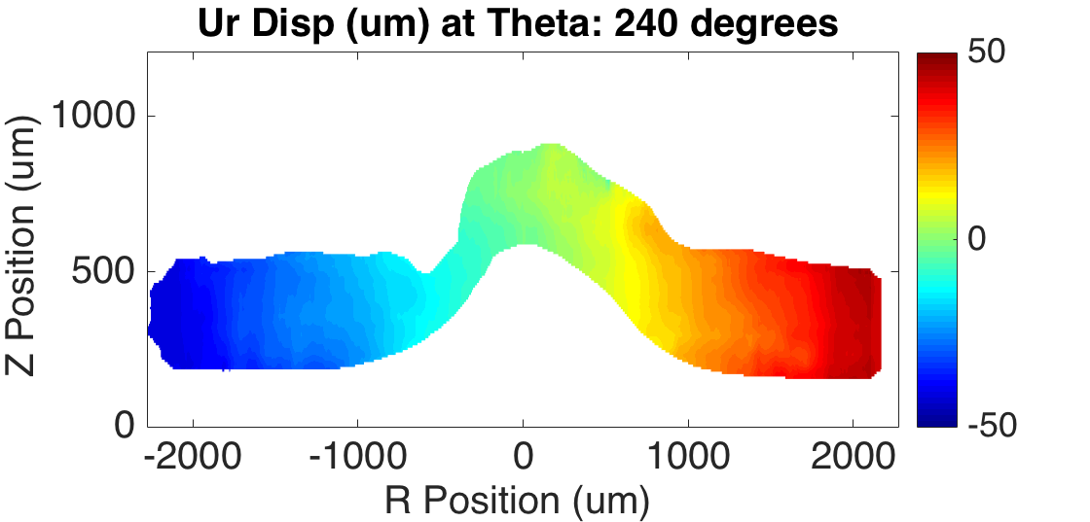
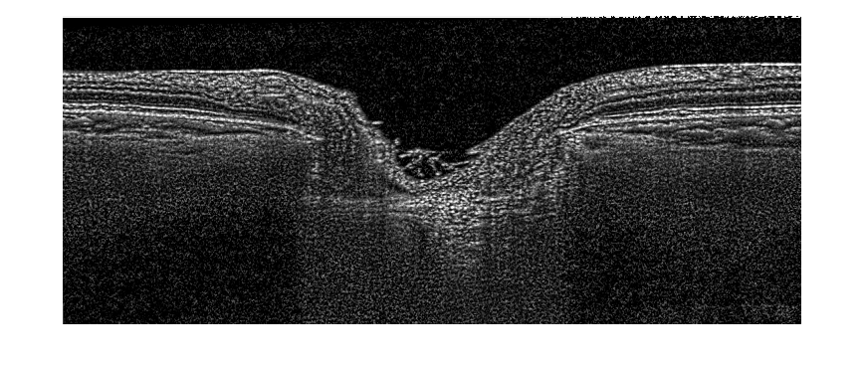
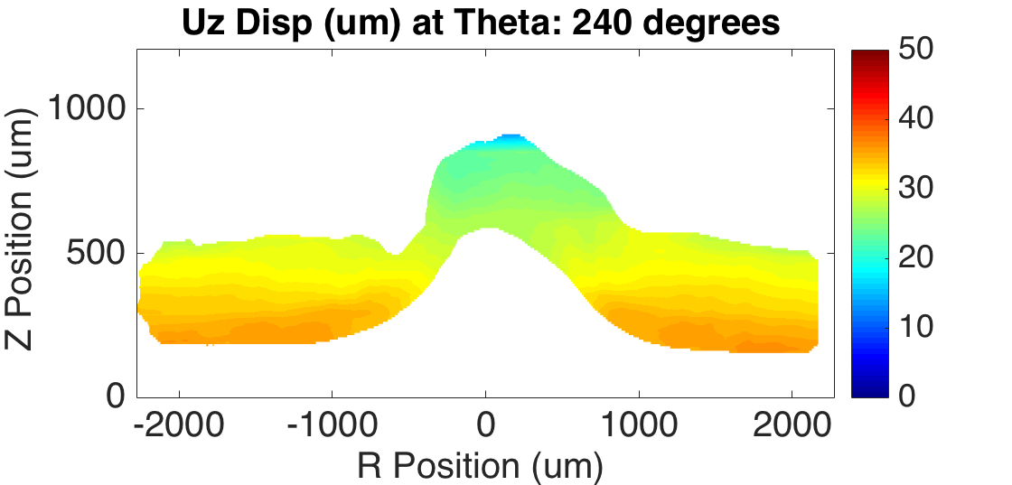
Recombine Slices & Differentiate Locally
Strain Method 1: U = C + ar + bz + ct
Fit a 3D polynomial to a 3D cylindrical wedge subset surrounding each point Issues: r & z strains are less accurate further out due to increased spacing between nearby slices. Strain fields looked very noisy
Strain Method 2: U = C + ar + bz U = C + at Fit a 2D polynomial to a square subset in the XZ plane around each point and evaluate the out-of-plane displacement partials using a 1D fit over 5 closest slices Issues: since there are 2 fits it is possible for there to be enough non-NaN data for fit1 or fit2 but not the other. Right now I have the strain set to NaN if either has too little data but this results in loss of data at edges

Slide 3
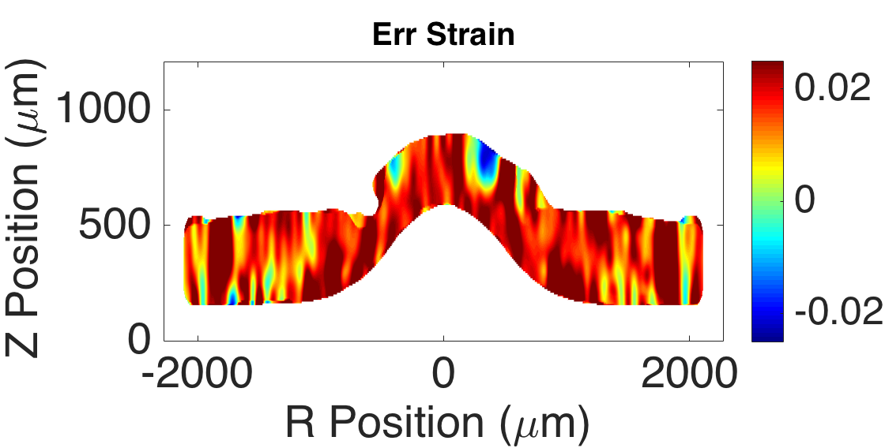
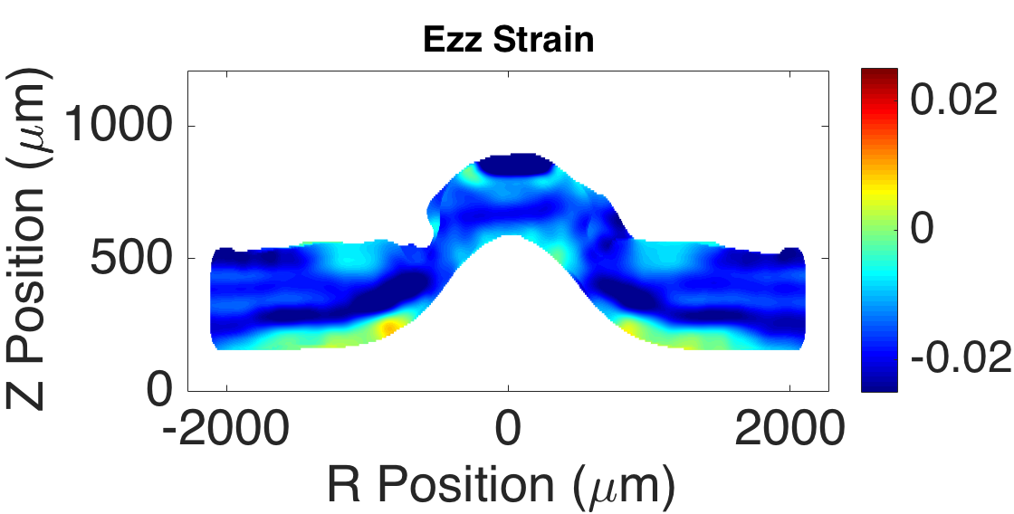
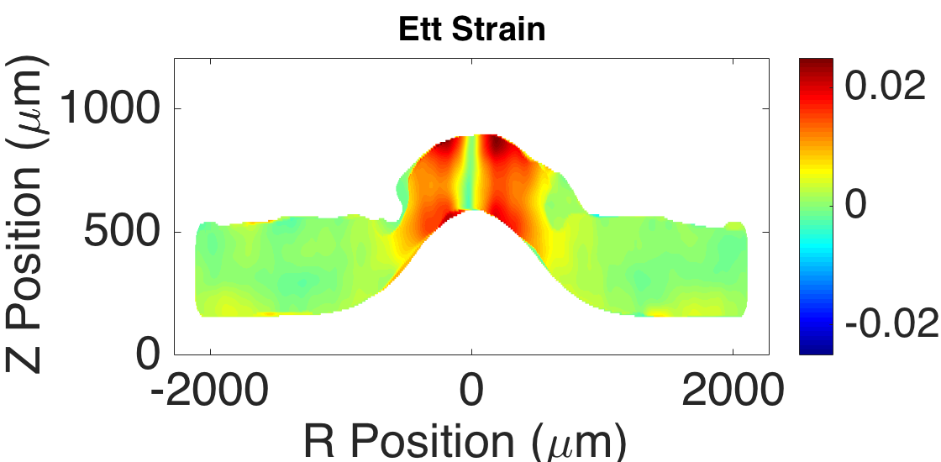
RFIDVC: Strains #2: F10,G11³,S11x5
Average: 1.87±1.37% Abs Error: 1.00±1.37%
Mean: -1.63±1.00% Abs Error: 0.72±1.00%
Applied Strain Field: Err: 2% strain, Ezz: -2% strain Ett, Erz, Ert, Ezt: 0% strain
Abs Error: Erz: 0.66±0.90% Ert: 0.67±0.87% Ert: 0.16±0.23% Error Filter 10 um, 3D Gaussian Filter 11x11x11, Strain Fit Box size: 11x11x5
Mean: 0.37±0.61% Abs Error: 0.42±0.61%
Notes:
Z resolution is actually very good in these volumes. It is only bad at the very deepest depths where signal blurs and fades out
X and Y resolution is subpixel in some regions even after resampling

Slide 4
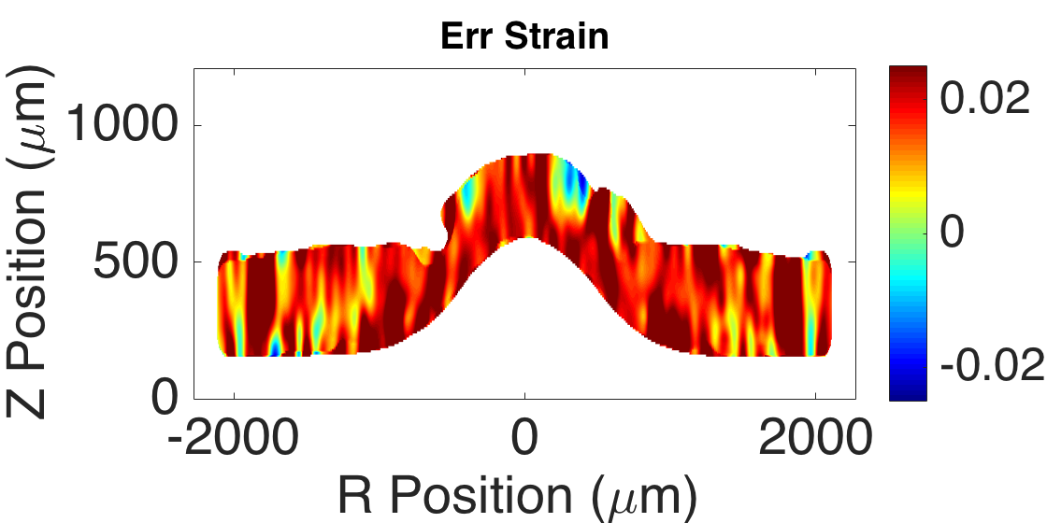
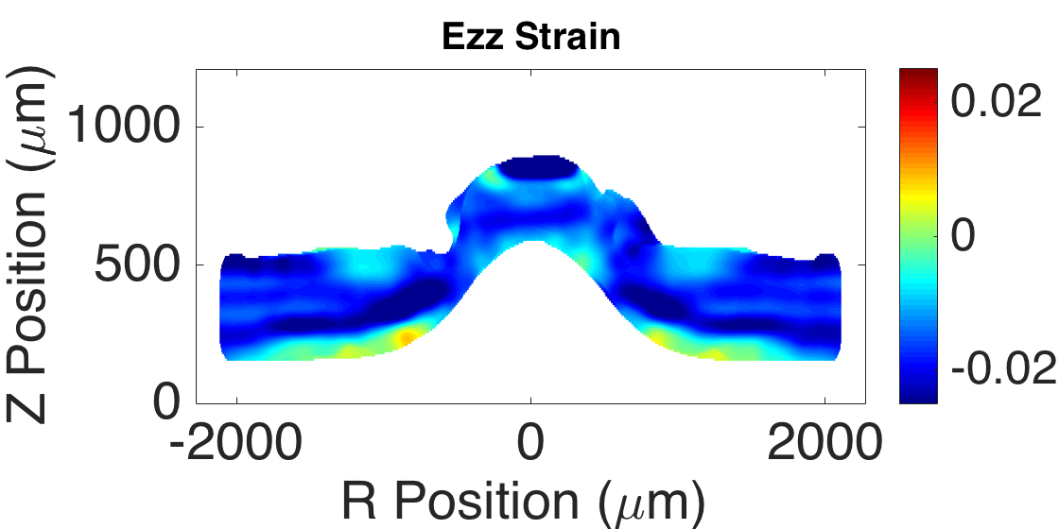
RFIDVC: Strains #2: F6,G11³,S11x5
Average: 1.88±1.27% Abs Error: 0.95±1.27%
Mean: -1.64±0.99% Abs Error: 0.71±0.99%
Applied Strain Field: Err: 2% strain, Ezz: -2% strain Ett, Erz, Ert, Ezt: 0% strain
Abs Error: Erz: 0.63±0.84% Ert: 0.65±0.84% Ert: 0.16±0.22% Error Filter 6 um, 3D Gaussian Filter 11x11x11, Strain Fit Box size: 11x11x5
Mean: 0.36±0.60% Abs Error: 0.41±0.60%
Notes:
Z resolution is actually very good in these volumes. It is only bad at the very deepest depths where signal blurs and fades out
X and Y resolution is subpixel in some regions even after resampling

Slide 5
RFIDVC: Strains #2: F6,G11³,S15x5
Average: 1.88±1.17% Abs Error: 0.88±1.17%
Mean: -1.65±0.88% Abs Error: 0.64±0.88%
Applied Strain Field: Err: 2% strain, Ezz: -2% strain Ett, Erz, Ert, Ezt: 0% strain
Abs Error: Erz: 0.61±0.81% Ert: 0.65±0.84% Ert: 0.16±0.22% Error Filter 6 um, 3D Gaussian Filter 11x11x11, Strain Fit Box size: 15x15x5
Mean: 0.36±0.60% Abs Error: 0.41±0.60%
Notes:
Z resolution is actually very good in these volumes. It is only bad at the very deepest depths where signal blurs and fades out
X and Y resolution is subpixel in some regions even after resampling

Slide 6
RFIDVC: Strains #2: F6,G11³,S21x5
Average: 1.88±0.103% Abs Error: 0.79±0.103%
Mean: -1.66±0.70% Abs Error: 0.54±0.70%
Applied Strain Field: Err: 2% strain, Ezz: -2% strain Ett, Erz, Ert, Ezt: 0% strain
Abs Error: Erz: 0.58±0.75% Ert: 0.65±0.83% Ert: 0.15±0.21% Error Filter 6 um, 3D Gaussian Filter 11x11x11, Strain Fit Box size: 21x21x5
Mean: 0.36±0.60% Abs Error: 0.41±0.60%
Notes:
Z resolution is actually very good in these volumes. It is only bad at the very deepest depths where signal blurs and fades out
X and Y resolution is subpixel in some regions even after resampling

Slide 7
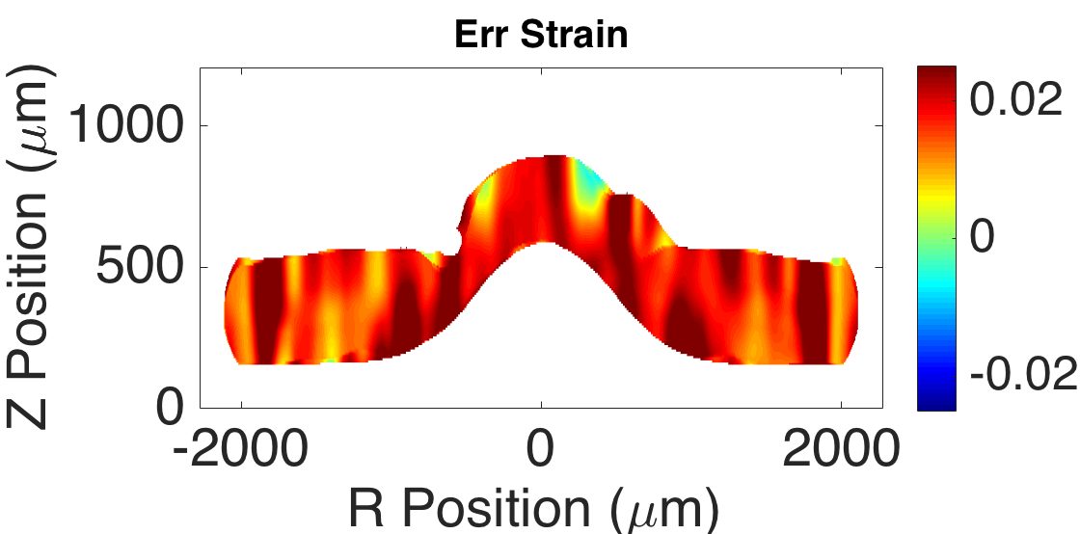
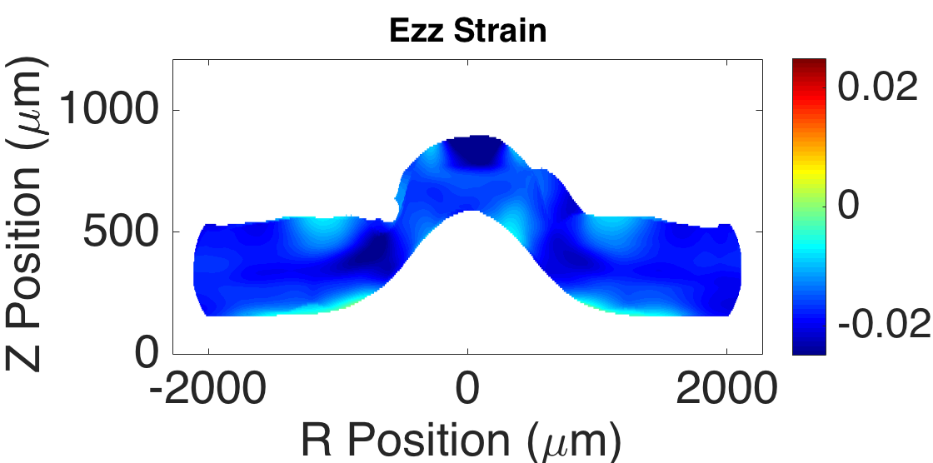
RFIDVC: Strains #2: F6,G11³,S31x5
Average: 1.87±0.83% Abs Error: 0.66±0.83%
Mean: -1.70±0.45% Abs Error: 0.41±0.45%
Applied Strain Field: Err: 2% strain, Ezz: -2% strain Ett, Erz, Ert, Ezt: 0% strain
Abs Error: Erz: 0.52±0.67% Ert: 0.64±0.82% Ert: 0.14±0.20% Error Filter 6 um, 3D Gaussian Filter 11x11x11, Strain Fit Box size: 31x31x5
Mean: 0.36±0.60% Abs Error: 0.41±0.60%
Notes:
Z resolution is actually very good in these volumes. It is only bad at the very deepest depths where signal blurs and fades out
X and Y resolution is subpixel in some regions even after resampling

Slide 8
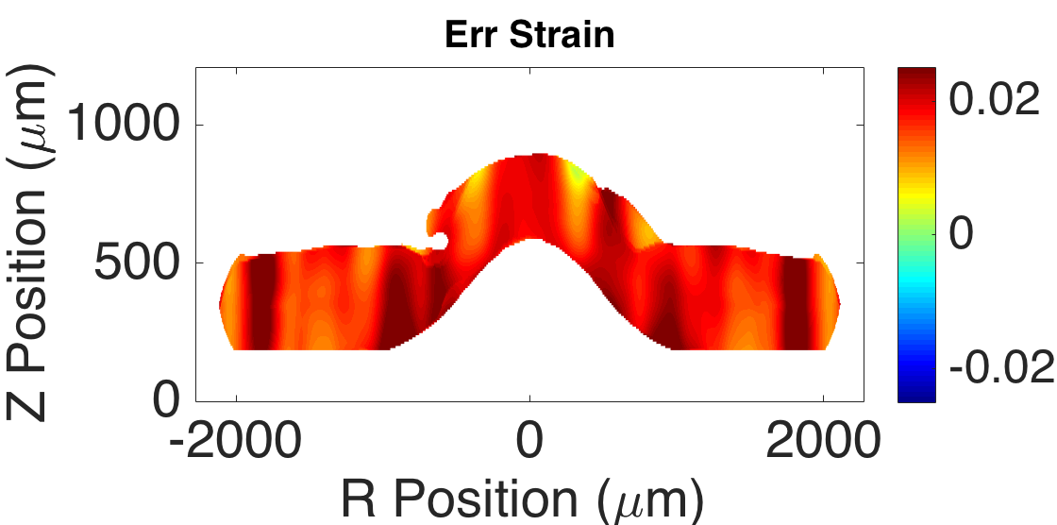
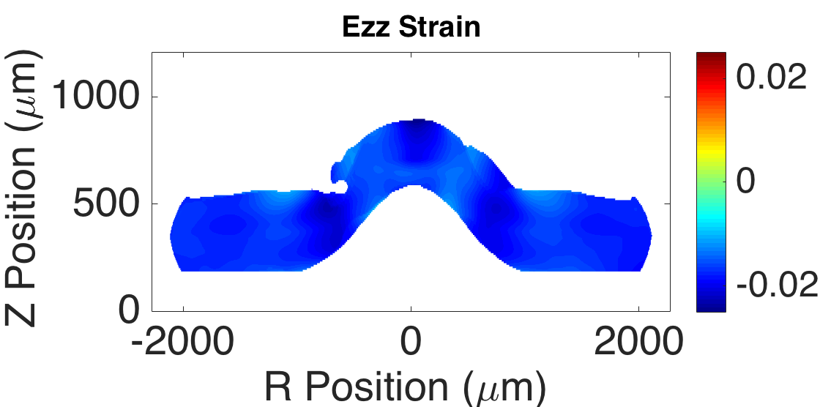
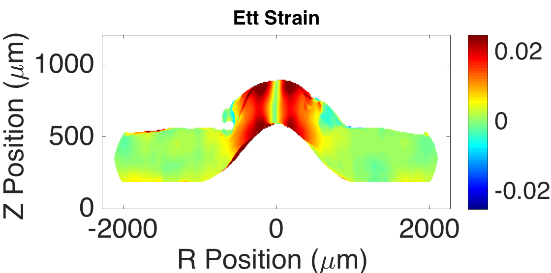
RFIDVC: Strains #2: F6,G11²,S49x5
Average: 1.84±0.60% Abs Error: 0.51±0.60%
Mean: -1.72±0.23% Abs Error: 0.31±0.31%
Applied Strain Field: Err: 2% strain, Ezz: -2% strain Ett, Erz, Ert, Ezt: 0% strain
Abs Error: Erz: 0.47±0.57% Ert: 0.78±1.13% Ert: 0.20±0.33% Error Filter 6 um, 2D Gaussian Filter 11x11 (R,Z), Strain Fit Box size: 49x49x5
Mean: 0.51±0.81% Abs Error: 0.58±0.81%
Notes:
Z resolution is actually very good in these volumes. It is only bad at the very deepest depths where signal blurs and fades out
X and Y resolution is subpixel in some regions even after resampling

Slide 9
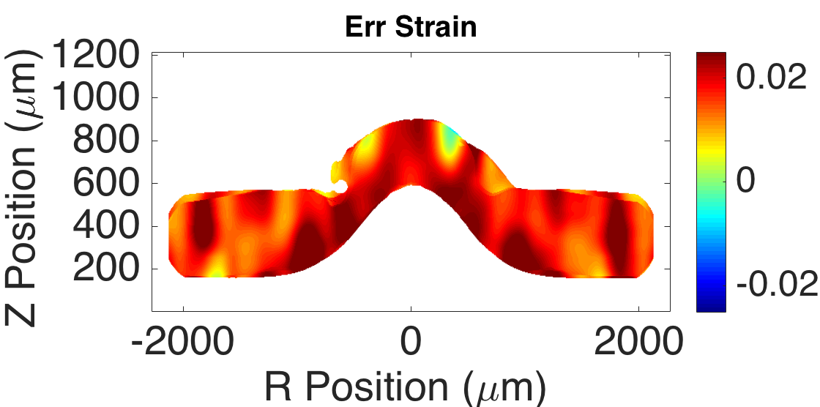
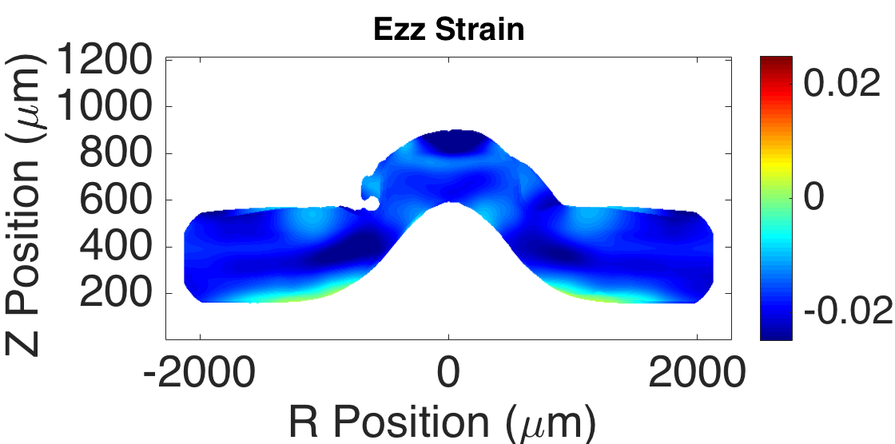
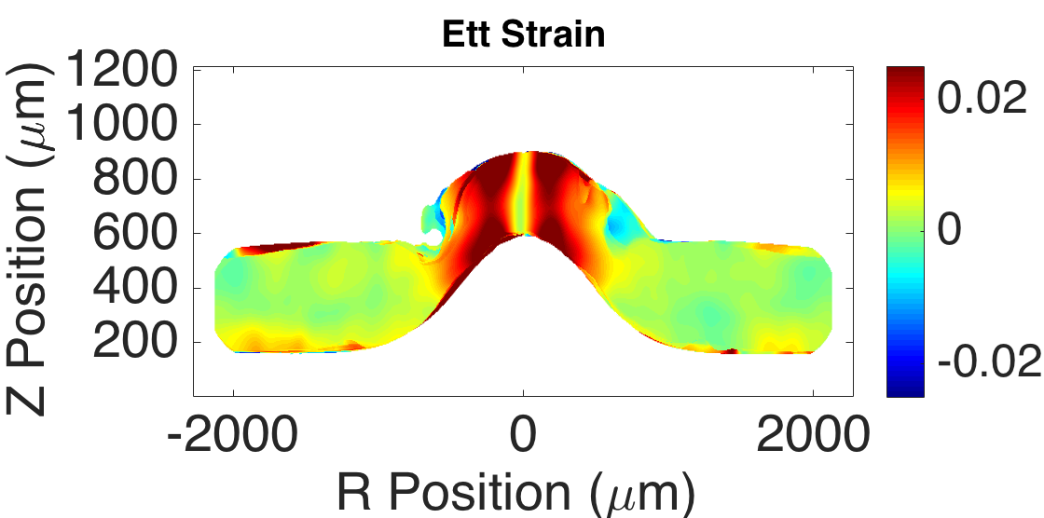
RFIDVC: Strains #2: I5,F6,G25S6²,S49x5
Average: 1.83±0.71% Abs Error: 0.59±0.71%
Mean: -1.75±0.53% Abs Error: 0.42±0.53%
Applied Strain Field: Err: 2% strain, Ezz: -2% strain Ett, Erz, Ert, Ezt: 0% strain
Abs Error: Erz: 0.62±0.78% Ert: 0.93±1.44% Ert: 0.27±0.44% Error Filter 6 um, 2D Gaussian Filter 11x11 (R,Z), Sigma – 6, Strain Fit Box size: 49x49x5, Calculation Spacing now 1x1x1 Note: By decreasing the calculation spacing, we have decreased the effective box fit size
Mean: 0.62±1.02% Abs Error: 0.72±1.02%
Notes:
Z resolution is actually very good in these volumes. It is only bad at the very deepest depths where signal blurs and fades out
X and Y resolution is subpixel in some regions even after resampling
Here I increase the iterations to result in a final calculation spacing of every pixel. Previously I did not do this when optimizing earlier settings to save time when running DVC, but when selecting the final strain and smoothing sizes it is important you use the final calculation spacing

Slide 10
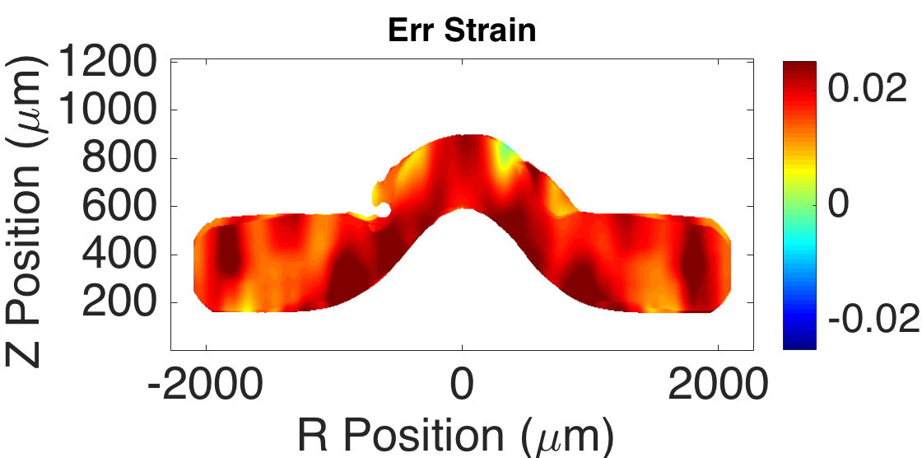
RFIDVC: Strains #2: I5,F6,G25S6²,S59x5
Average: 1.86±0.65% Abs Error: 0.54±0.65%
Mean: -1.82±0.46% Abs Error: 0.35±0.46%
Applied Strain Field: Err: 2% strain, Ezz: -2% strain Ett, Erz, Ert, Ezt: 0% strain
Abs Error: Erz: 0.62±0.77% Ert: 0.99±1.60% Ezt: 0.28±0.44% Error Filter 6 um, 2D Gaussian Filter 11x11 (R,Z), Sigma – 6, Strain Fit Box size: 59x59x5, Calculation Spacing 1x1x1
Mean: 0.64±1.06% Abs Error: 0.74±1.06%
Notes:
Z resolution is actually very good in these volumes. It is only bad at the very deepest depths where signal blurs and fades out
X and Y resolution is subpixel in some regions even after resampling

Slide 11
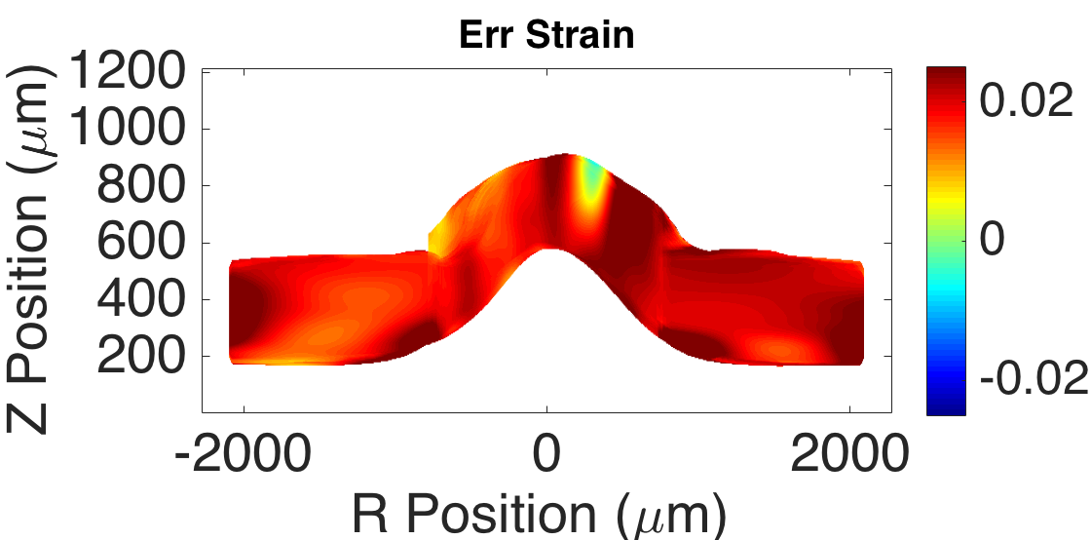
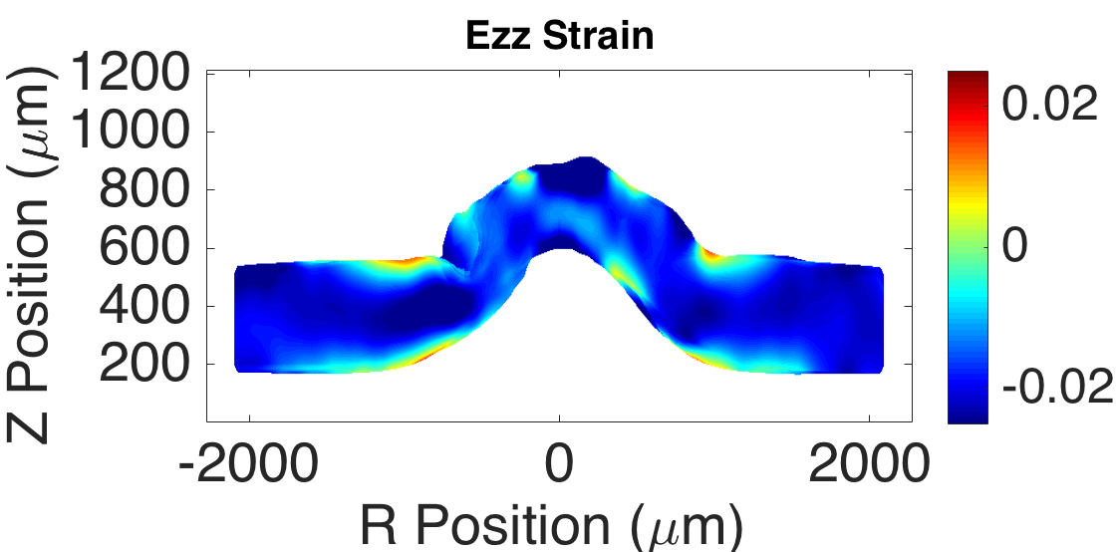
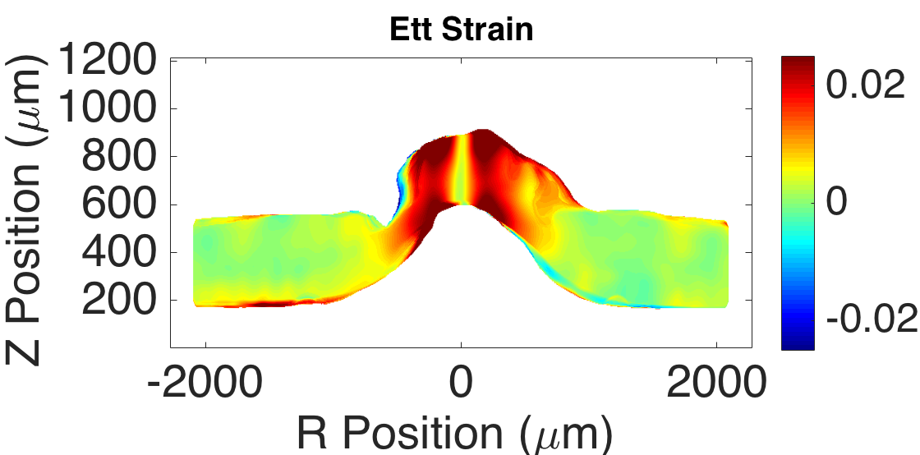
RFIDVC: I5,Strain #3:1Dn3,LC59
Average: 2.01±0.65% Abs Error: 0.50±0.65%
Mean: -1.84±0.84% Abs Error: 0.56±0.84%
Applied Strain Field: Err: 2% strain, Ezz: -2% strain Ett, Erz, Ert, Ezt: 0% strain
Abs Error: Erz: 0.74±0.96% Ert: 1.53±2.03% Ezt: 0.37±0.51% Error Filter 6 um, 2D Gaussian Filter 11x11 (R,Z), Sigma – 6, New Strain Method: 2D box fit in LC of 59x59 and polynomial fit in RNFL/Choroid of n = 3
Mean: 0.61±1.28% Abs Error: 0.85±1.28%
Notes:
Z resolution is actually very good in these volumes. It is only bad at the very deepest depths where signal blurs and fades out
X and Y resolution is subpixel in some regions even after resampling

Slide 12
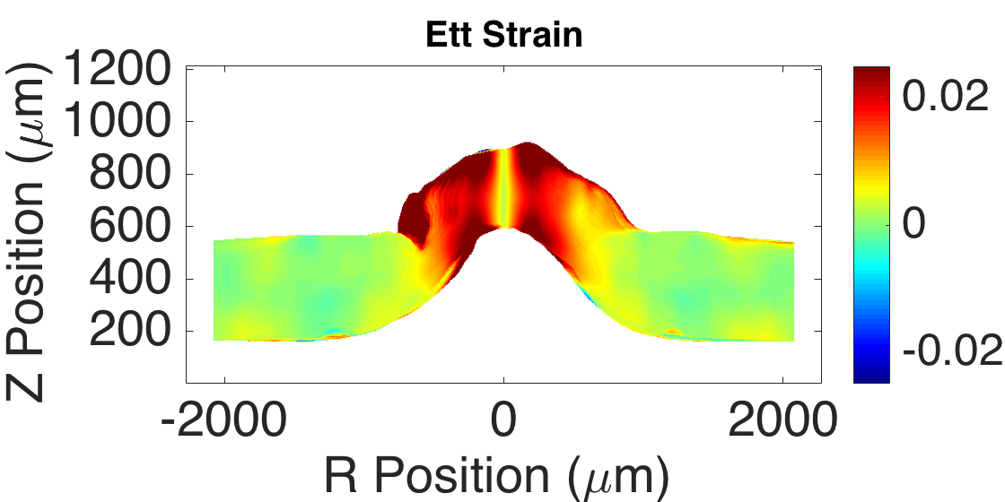
RFIDVC: I5,Strain #3:1Dn3,LC59, Leave borders in T,R domain for 1D fits
Average: 1.93±0.58% Abs Error: 0.44±0.58%
Mean: -1.82±0.90% Abs Error: 0.59±0.90%
Using full 48 T-slices + 4 border: -7.5 → 375 Leaving the border on Left/Right in R fits, trim after strain calculation
Applied Strain Field: Err: 2% strain, Ezz: -2% strain Ett, Erz, Ert, Ezt: 0% strain
Abs Error: Erz: 0.76±0.99% Ert: 1.07±1.41% Ezt: 0.23±0.33% Error Filter 6 um, 2D Gaussian Filter 11x11 (R,Z), Sigma – 6, New Strain Method: 2D box fit in LC of 59x59 and polynomial fit in RNFL/Choroid of n = 3, only removing data at image edges after strain fit
Mean: 0.58±1.13% Abs Error: 0.67±1.13%
Notes:
Z resolution is actually very good in these volumes. It is only bad at the very deepest depths where signal blurs and fades out
X and Y resolution is subpixel in some regions even after resampling

Slide 13
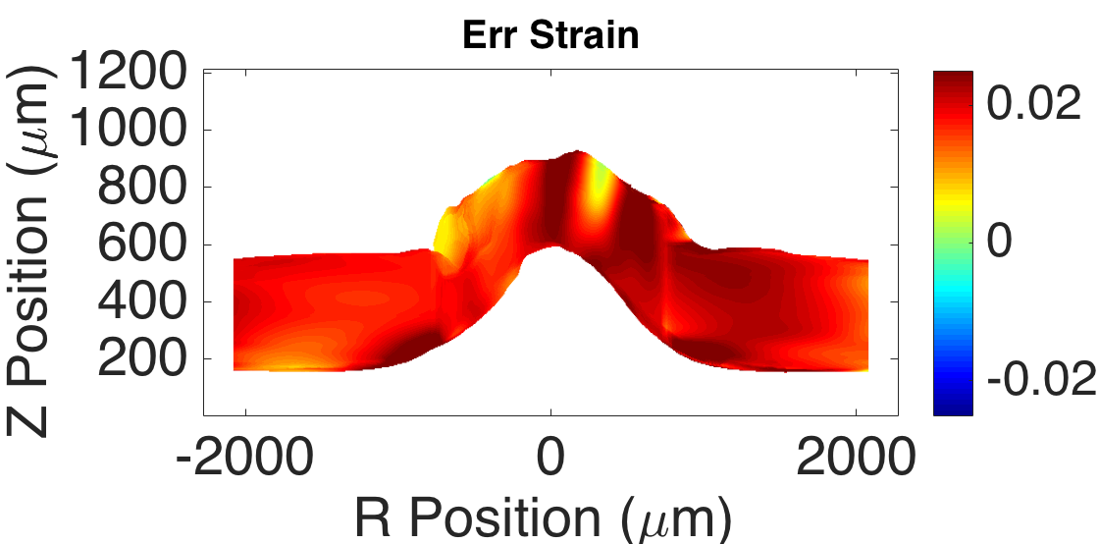
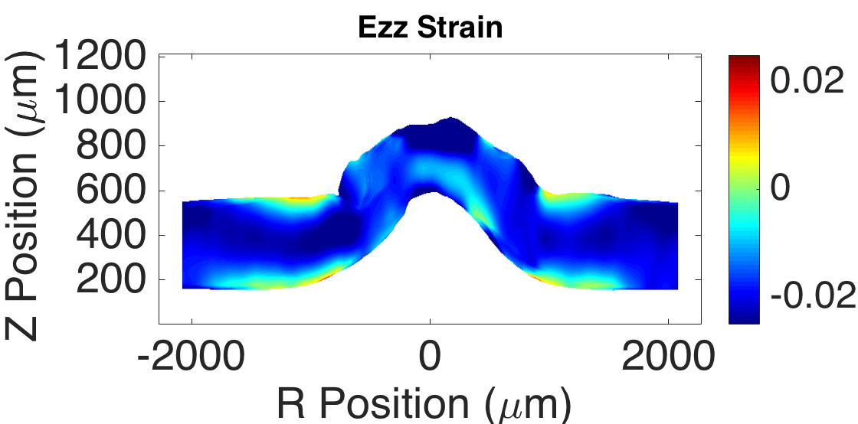
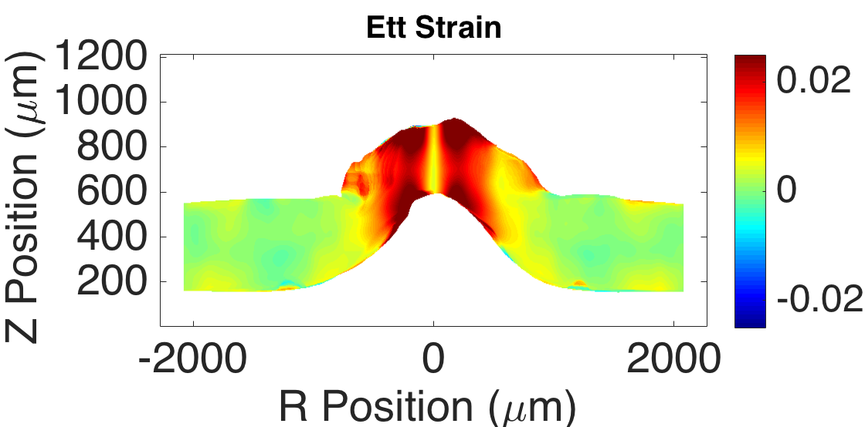
RFIDVC: I5,Strain #3:1Dn3,LC59, OF + CC 0.05 → CC 0.065 after Strain Calc
Average: 1.92±0.54% Abs Error: 0.42±0.54%
Mean: -1.85±0.93% Abs Error: 0.62±0.93%
Instead of segmenting the volume perfectly from the background with CC = 0.065, we use the lower CC = 0.05 so that less accurate edges remain, then calculate strains, then segment the volume. This will hopefully remove edge effects in the Z fits
Applied Strain Field: Err: 2% strain, Ezz: -2% strain Ett, Erz, Ert, Ezt: 0% strain
Abs Error: Erz: 0.71±0.92% Ert: 1.04±1.36% Ezt: 0.23±0.33%
Mean: 0.58±1.11% Abs Error: 0.66±1.11%
Notes:
Z resolution is actually very good in these volumes. It is only bad at the very deepest depths where signal blurs and fades out
X and Y resolution is subpixel in some regions even after resampling

Slide 14
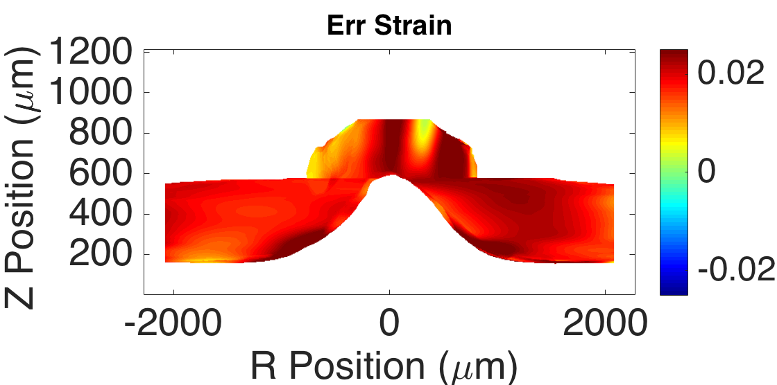
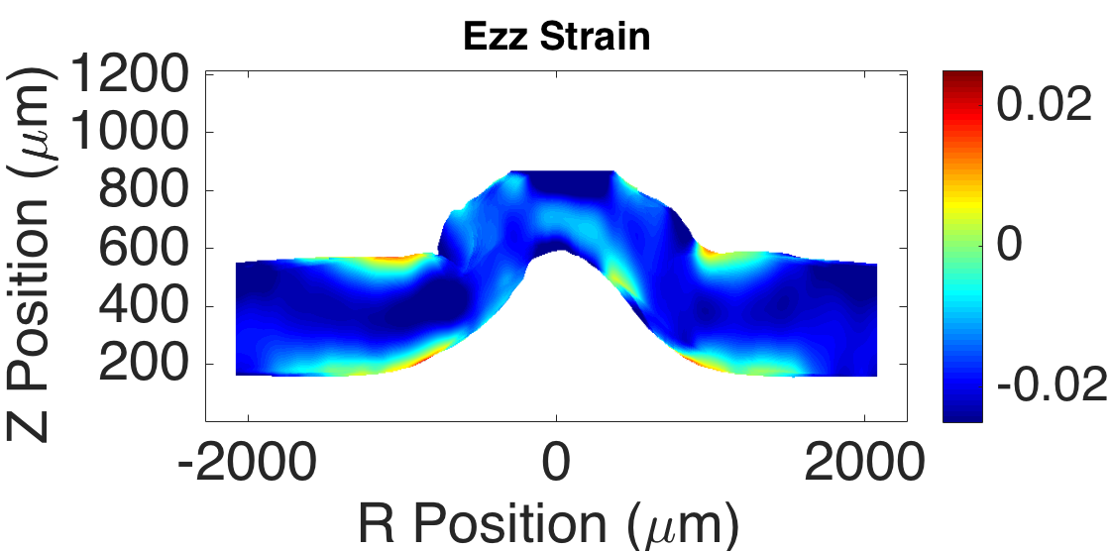
RFIDVC: I5,Strain #3:1Dn3,LC59, OF + CC 0.055 → CC 0.065 after Strain Calc
Measure Name | RNFL Mean | Std | LC Mean | Std | Applied Strain
E_{RR} Average | 1.91% | 0.45% | 1.91% | 0.80% | 2.00%
E_{ZZ} Average | -1.77% | 0.75% | -1.91% | 0.98% | -2.00%
E_{RR} Abs Error | 0.36% | 0.45% | 0.63% | 0.80% | 0.00%
E_{ZZ} Abs Error | 0.55% | 0.75% | 0.69% | 0.98% | 0.00%
E_{RZ} Abs Error | 0.72% | 0.94% | 0.75% | 0.92% | 0.00%
E_{TT} Abs Error | 0.35% | 0.67% | 1.83% | 1.60% | 0.00%
E_{RT} Abs Error | 1.08% | 1.40% | 0.89% | 1.27% | 0.00%
E_{ZT} Abs Error | 0.21% | 0.30% | 0.29% | 0.37% | 0.00%
Abs Error Mean | 0.55% | 0.75% | 0.85% | 0.99%
New Error Summary Table, Dividing error by tissue region, so I can focus on improving remaining error in the LC
Notes:
Z resolution is actually very good in these volumes. It is only bad at the very deepest depths where signal blurs and fades out
X and Y resolution is subpixel in some regions even after resampling

Slide 15
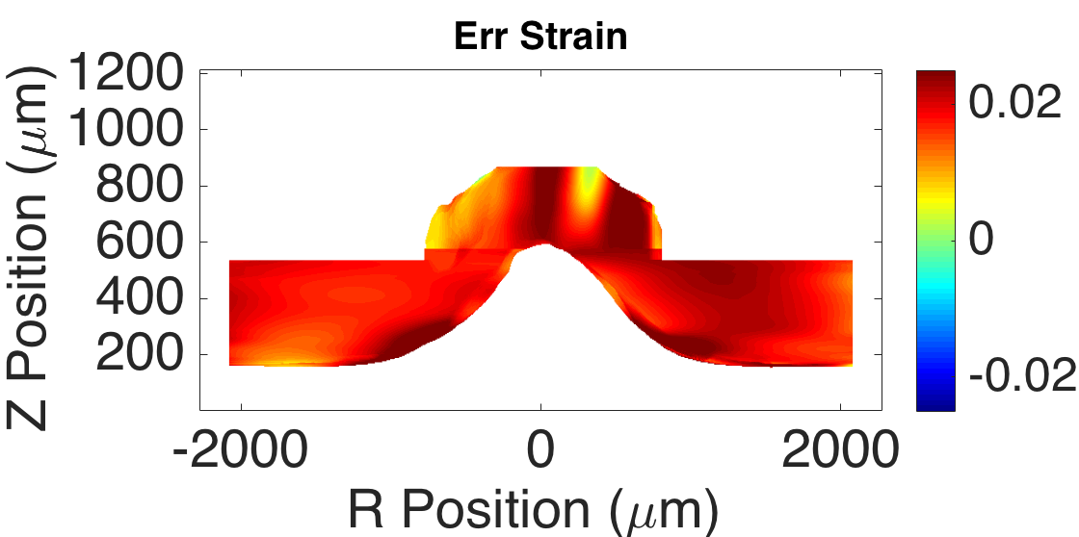
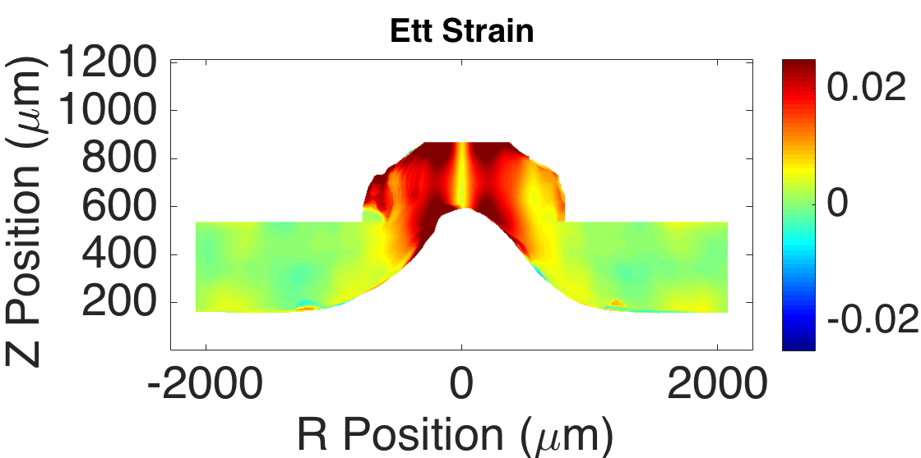
RFIDVC: I5,Strain #3:1Dn3,LC59, OF + CC 0.055 → CC 0.065, BorderZ
Measure Name | RNFL Mean | Std | LC Mean | Std | Applied Strain
E_{RR} Average | 1.90% | 0.45% | 1.91% | 0.80% | 2.00%
E_{RR} Average | -1.83% | 0.69% | -1.89% | 0.99% | -2.00%
E_{XX} Abs Error | 0.36% | 0.45% | 0.63% | 0.80% | 0.00%
E_{ZZ} Abs Error | 0.50% | 0.69% | 0.70% | 0.99% | 0.00%
E_{RZ} Abs Error | 0.71% | 0.94% | 0.75% | 0.92% | 0.00%
E_{TT} Abs Error | 0.36% | 0.68% | 1.85% | 1.62% | 0.00%
E_{RT} Abs Error | 1.06% | 1.35% | 0.89% | 1.27% | 0.00%
E_{ZT} Abs Error | 0.20% | 0.28% | 0.29% | 0.37% | 0.00%
Abs Error Mean | 0.53% | 0.73% | 0.85% | 0.99%
- Cut off RNFL region 10 pixels in front of the defined LC starting point (it usually has faded out by here) to remove edge effects in Z-fits on the top
Notes:
Z resolution is actually very good in these volumes. It is only bad at the very deepest depths where signal blurs and fades out
X and Y resolution is subpixel in some regions even after resampling

Slide 16
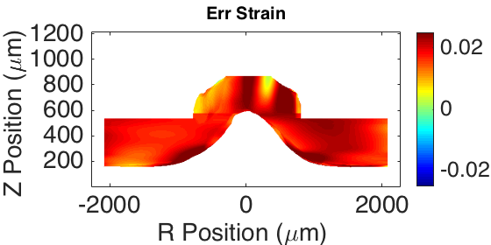
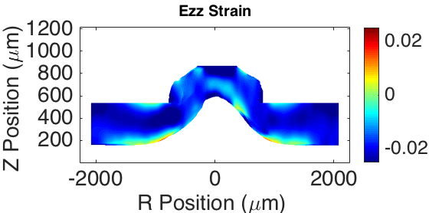
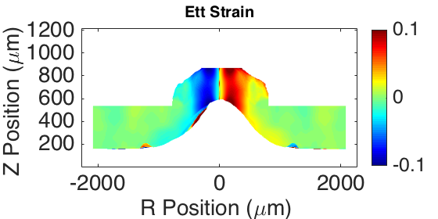
RFIDVC: I5,Strain #3:1Dn3,LC59, OF + CC 0.055 → CC 0.065, U_{t} & t in um
Measure Name | RNFL Mean | Std | LC Mean | Std | Applied Strain
E_{RR} Average | 1.90% | 0.45% | 1.91% | 0.80% | 2.00%
E_{ZZ} Average | -1.83% | 0.69% | -1.90% | 0.99% | -2.00%
E_{RR} Abs Error | 0.36% | 0.45% | 0.63% | 0.80% | 0.00%
E_{ZZ} Abs Error | 0.50% | 0.69% | 0.70% | 0.99% | 0.00%
E_{RZ} Abs Error | 0.71% | 0.94% | 0.75% | 0.92% | 0.00%
E_{TT} Abs Error | 0.85% | 2.08% | 5.41% | 5.92% | 0.00%
E_{RT} Abs Error | 0.10% | 0.21% | 0.65% | 1.75% | 0.00%
E_{ZT} Abs Error | 0.03% | 0.07% | 0.22% | 0.37% | 0.00%
Abs Error Mean | 0.42% | 0.74% | 1.39% | 1.79%
- Displacement gradients of U_{z} and U_{r} with respect t were inaccurate due to t vector not being in um. This is why the RT error was so high. In this formulation I put everything in terms of microns and assume Theta displacements are an arc length of microns. Note the the high strains near R=0
Notes:
Z resolution is actually very good in these volumes. It is only bad at the very deepest depths where signal blurs and fades out
X and Y resolution is subpixel in some regions even after resampling

Slide 17
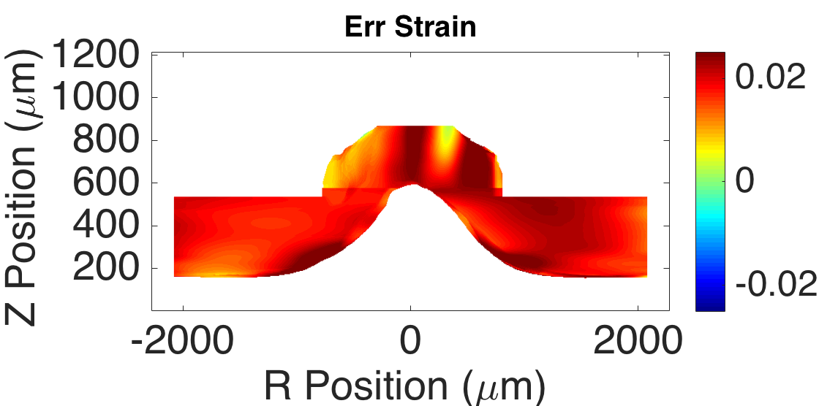
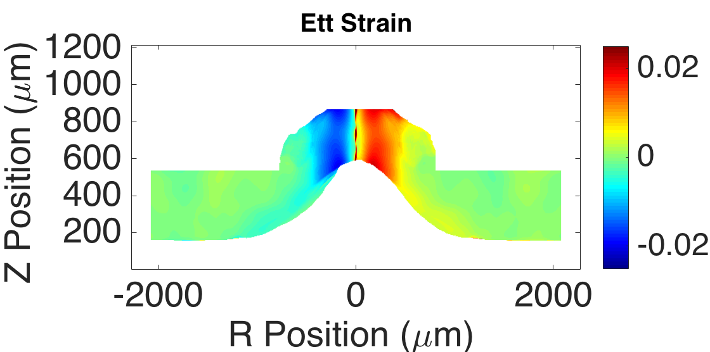
RFIDVC: I5,Strain #3:1Dn3,LC59, U_{t} G1x49, sigma=22, G41, sigma=6
Measure Name | RNFL Mean | Std | LC Mean | Std | Applied Strain
E_{RR} Average | 1.91% | 0.44% | 1.90% | 0.79% | 2.00%
E_{ZZ} Average | -1.78% | 0.71% | -1.86% | 0.93% | -2.00%
E_{RR} Abs Error | 0.36% | 0.44% | 0.62% | 0.79% | 0.00%
E_{ZZ} Abs Error | 0.52% | 0.71% | 0.68% | 0.93% | 0.00%
E_{RZ} Abs Error | 0.69% | 0.91% | 0.73% | 0.89% | 0.00%
E_{TT} Abs Error | 0.16% | 0.30% | 1.09% | 1.27% | 0.00%
E_{RT} Abs Error | 0.32% | 0.43% | 0.68% | 1.71% | 0.00%
E_{ZT} Abs Error | 1.10% | 1.43% | 0.53% | 0.69% | 0.00%
Abs Error Mean | 0.52% | 0.71% | 0.72% | 1.05%
Here we apply a separate, stronger 1D Gaussian filter in T direction to suppress the oscillation in the Ut displacements prior to taking the gradient
Notes:
Z resolution is actually very good in these volumes. It is only bad at the very deepest depths where signal blurs and fades out
X and Y resolution is subpixel in some regions even after resampling

Slide 18
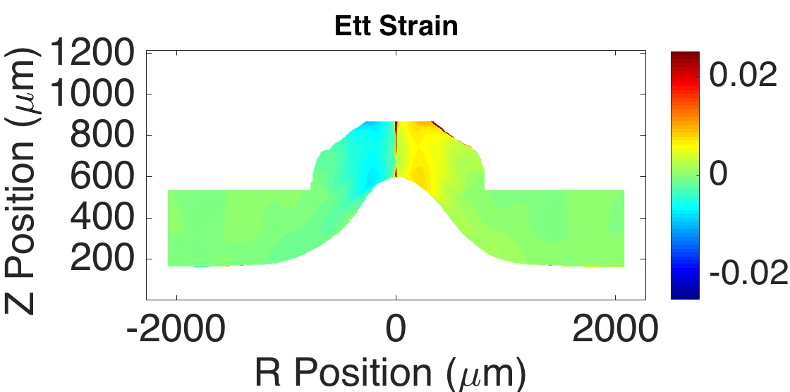
RFIDVC: I5,Strain #3:1Dn3,LC59, U_{t} G1x49, sigma=23, G49, sigma=12 (GF4)
Measure Name | RNFL Mean | Std | LC Mean | Std | Applied Strain
E_{XX} Average | 1.90% | 0.42% | 1.94% | 0.65% | 2.00%
E_{ZZ} Average | -1.71% | 0.61% | -1.73% | 0.57% | -2.00%
E_{RR} Abs Error | 0.35% | 0.42% | 0.51% | 0.65% | 0.00%
E_{ZZ} Abs Error | 0.47% | 0.61% | 0.50% | 0.57% | 0.00%
E_{RZ} Abs Error | 0.58% | 0.74% | 0.64% | 0.76% | 0.00%
E_{TT} Abs Error | 0.06% | 0.12% | 0.53% | 0.66% | 0.00%
E_{RT} Abs Error | 0.29% | 0.38% | 0.54% | 1.40% | 0.00%
E_{ZT} Abs Error | 0.89% | 1.14% | 0.47% | 0.62% | 0.00%
Abs Error Mean | 0.44% | 0.57% | 0.53% | 0.78%
Even stronger Gaussian filter in T direction
Results: T partial issues near R=0 mostly fixed, error in R & Z about the same
Notes:
Z resolution is actually very good in these volumes. It is only bad at the very deepest depths where signal blurs and fades out
X and Y resolution is subpixel in some regions even after resampling

Slide 19
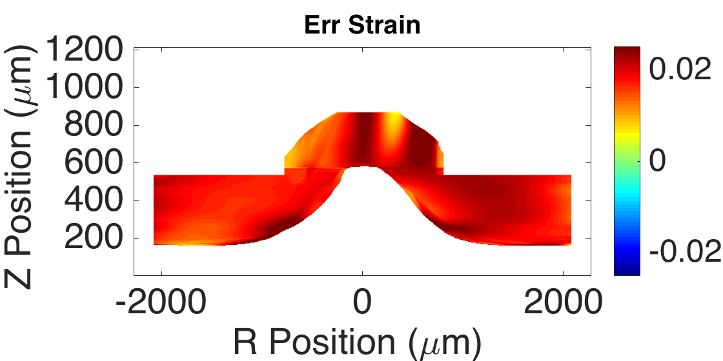
RFIDVC: I5,Strain #3:1Dn3,LC59x1, GF4 CC0.055 raw disp, smooth disp
Measure Name | RNFL Mean | Std | LC Mean | Std | Applied Strain
E_{RR} Average | 1.90% | 0.42% | 1.94% | 0.65% | 2.00%
E_{ZZ} Average | -1.71% | 0.61% | -1.73% | 0.57% | -2.00%
E_{RR} Abs Error | 0.35% | 0.42% | 0.51% | 0.65% | 0.00%
E_{ZZ} Abs Error | 0.47% | 0.61% | 0.50% | 0.57% | 0.00%
E_{RZ} Abs Error | 0.58% | 0.74% | 0.64% | 0.76% | 0.00%
E_{TT} Abs Error | 0.06% | 0.12% | 0.50% | 0.55% | 0.00%
E_{RT} Abs Error | 0.29% | 0.38% | 0.39% | 0.60% | 0.00%
E_{ZT} Abs Error | 0.89% | 1.14% | 0.43% | 0.56% | 0.00%
Abs Error Mean | 0.44% | 0.57% | 0.50% | 0.62%
Here I tried two CC thresholds, starting with CC 0.055, and then applying a more stringent CC of 0.065 after strain calculation to remove edge effects
I also remove the calculations within 3 pixels of R = 0 and interpolate to remove line artifacts near this point
Notes:
Z resolution is actually very good in these volumes. It is only bad at the very deepest depths where signal blurs and fades out
X and Y resolution is subpixel in some regions even after resampling

Slide 20
Current Settings
Optimal Displacement Error Settings: Image Enhancement: CLAHE: B12S3.5 → Gamma Shift: 1.75 Convergence: 4 Iterations, 128x128x32 → 48x48x16 Correlation Coefficient Threshold: 0.065 Error Filtering: > 6 um
Optimal Strain Error Settings: Correlation Coefficient Threshold: 0.055 before and 0.065 after Gaussian Smoothing Error Filtering: > 6 um
1D Polynomial strain fitting in RNFL & T directions: n=3
Local strain fitting in LC: box size: 59x59, linear
2D gaussian smoothing filter in each RZ plane: 49x49, σ=12 1D gaussian smoothing filter in T: 49, σ=23 Interpolate partial derivatives w.r.t. T around R=0
Notes:
Z resolution is actually very good in these volumes. It is only bad at the very deepest depths where signal blurs and fades out
X and Y resolution is subpixel in some regions even after resampling

